Slide 1
Agri-food CO2 emission

Slide 2
Contents
Introduction
Dataset Overview
Components
Data Visualization
Hypothesis
Dashboard
Conclusion
Reference

Slide 3
Introduction
The Agri-Food CO2 Emission Dataset Forecasting with Machine Learning project is an ambitious endeavor that aims to analyze and predict carbon dioxide (CO2) emissions associated with the agricultural and food sectors. The dataset used in this project, available on Kaggle and curated by Alessandro Lobello, encompasses a comprehensive collection of relevant variables, offering valuable insights into the environmental impact of various agri-food activities.

Slide 4
Dataset Overview
The agricultural CO2 emission dataset has been constructed by merging and reprocessing approximately a dozen individual datasets from the Food and Agriculture Organization (FAO) and data from IPCC. These datasets were, cleaned, preprocessed and merged to create a comprehensive and cohesive dataset for analysis and forecasting purposes.

Slide 5
Components
Some of the key components in Agrifood CO2 Emission
Savanna fires: Emissions from fires in savanna ecosystems.
Forest fires: Emissions from fires in forested areas.
Crop Residues: Emissions from burning or decomposing leftover plant material after crop harvesting.
Rice Cultivation: Emissions from methane released during rice cultivation.
Drained organic soils (CO2): Emissions from carbon dioxide released when draining organic soils.
Rural population: Number of people living in rural areas.
Urban population: Number of people living in urban areas.
Total Population - Male: Total number of male individuals in the population.
Total Population - Female: Total number of female individuals in the population.
total emission: Total greenhouse gas emissions from various sources.
Average Temperature °C: The average increasing of temperature (by year) in degrees Celsius

Slide 6
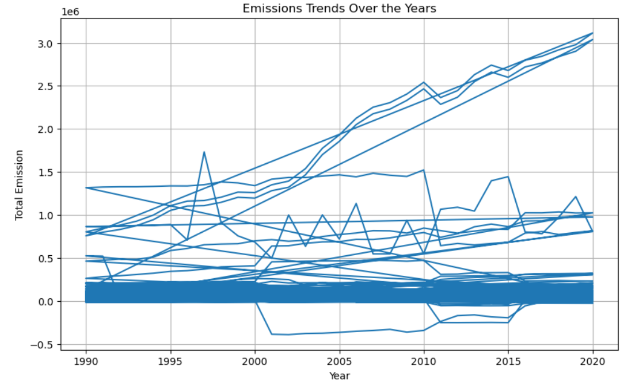
Emissions Trends Over the Years
Data Visualization

Slide 7
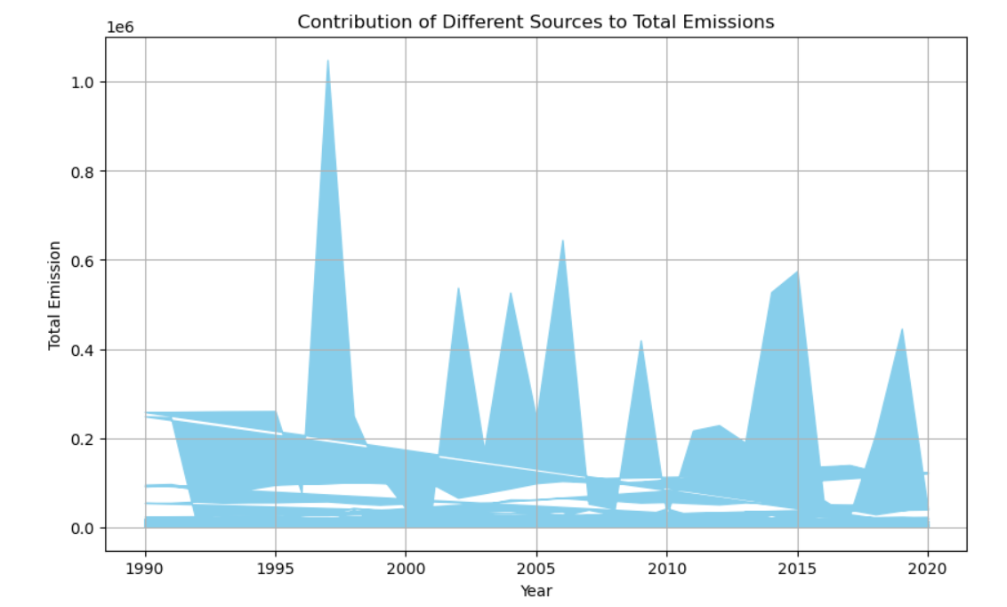
Contribution of Different Sources to Total Emissions
Data Visualization

Slide 8
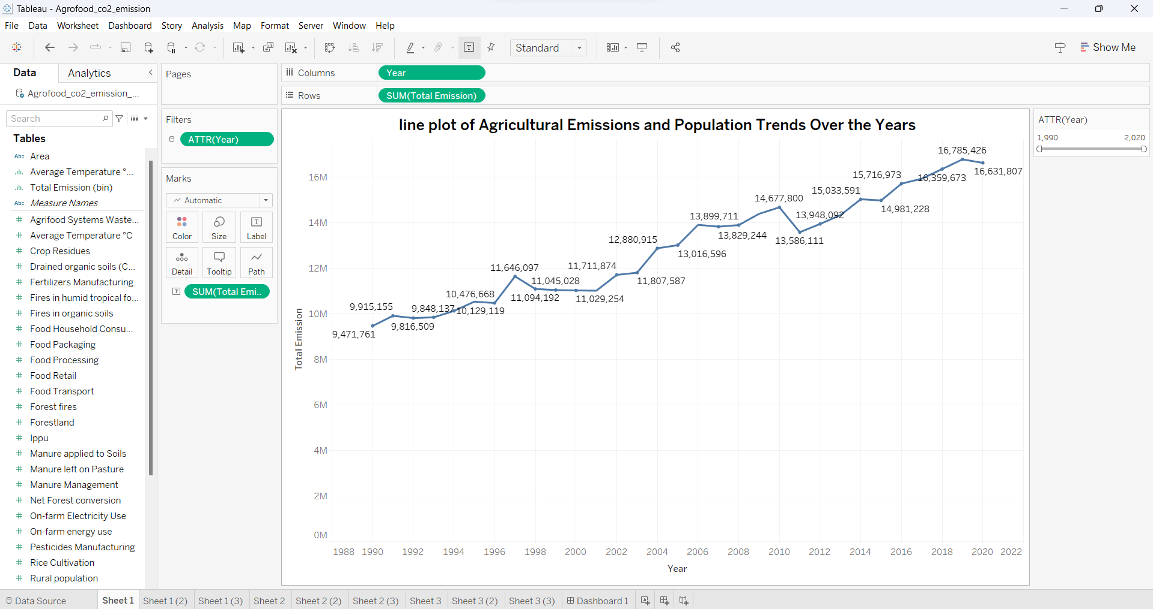
1.Agricultural Emissions and Population Trends Over the Years
Hypothesis

Slide 9
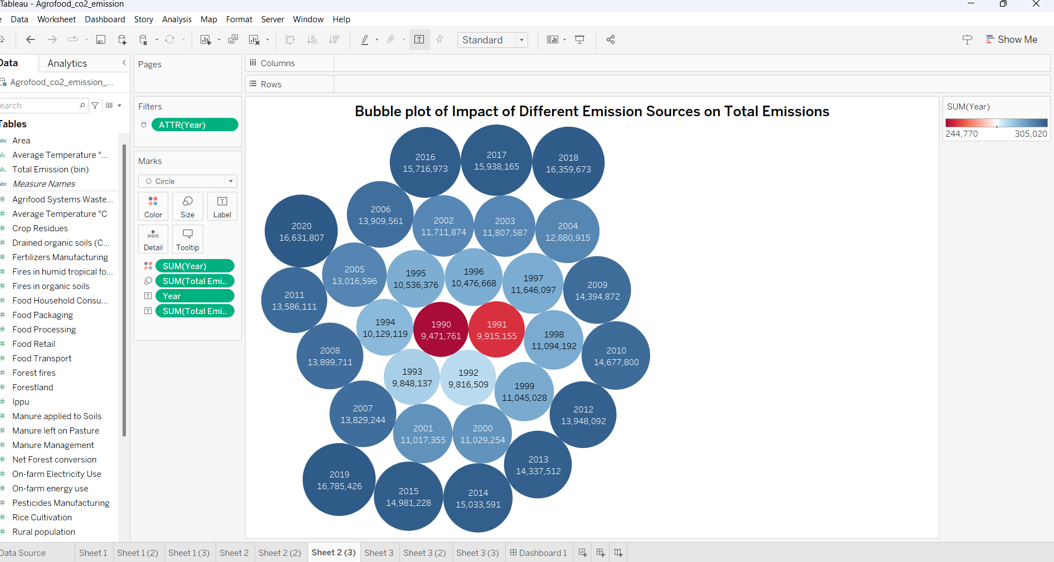
2. Impact of Different Emission Sources on Total Emissions.
Hypothesis

Slide 10
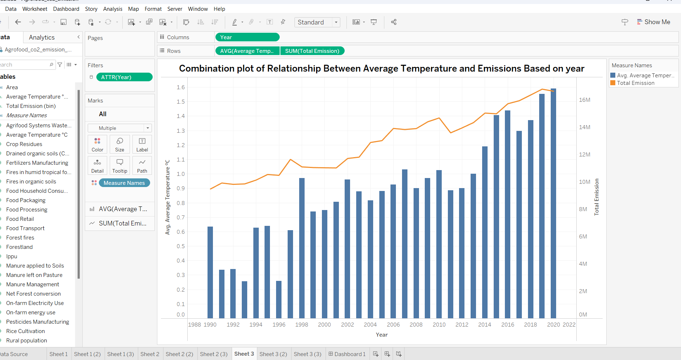
3. Relationship Between Average Temperature and Emissions Based on year.
Hypothesis

Slide 11
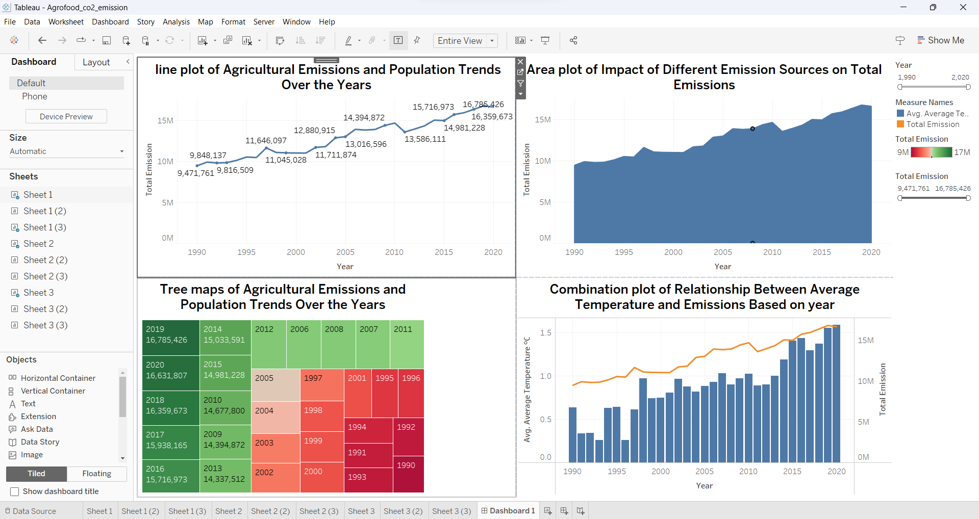
Dashboard
In dashboard the four charts together show that agricultural emissions have been increasing steadily over the years, with the largest increase in emissions coming from the livestock sector.

Slide 12
Conclusion
The project underscores the agri-food sector's significant role in global CO2 emissions and climate change. Understanding emissions is key for shaping sustainable policies. Machine learning and forecasting aid in developing effective strategies. Prioritizing sustainability and responsible agricultural practices will lead to a more sustainable future.

Slide 13
References
[1]. Co2 Emissions by Hannah Ritchie and Max Roser
website: https://ourworldindata.org/co2-emissions
[2]. Co2 Emissions in 2022 by International Energy Agency
website: https://www.iea.org/reports/co2-emissions-in-2022
[3]. Emissions data are sourced from Climate Watch Historical GHG Emissions(2020)
website: https://data.worldbank.org/indicator/EN.ATM.CO2E.PC

Slide 14
Thank you

